Slide 1
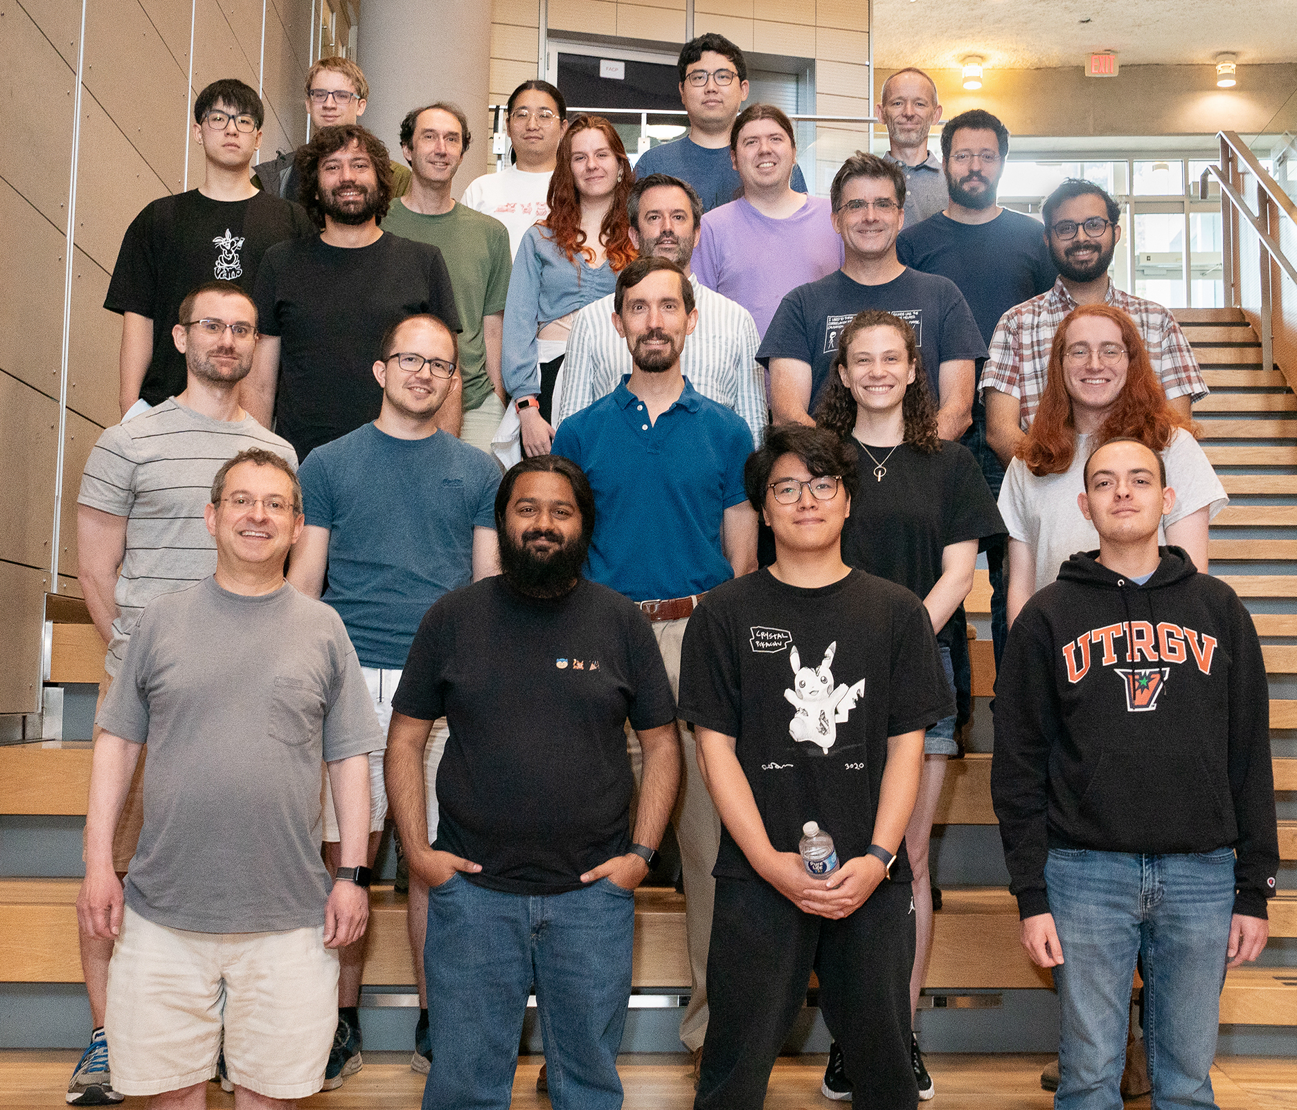

Advanced Topics
Travis Hance (and the Verus Team)
MPI-SWS (to join soon)
https://verus.rs/

Slide 2
Unsafe Code

Slide 3
Unsafe Code

Slide 4

What is unsafe code?
Definition attempt #1:
Unsafe code is code that opts the programmer out of the memory-safety guaranteed by Rust’s type system
fn oh_no() {
let p: *mut u64 = std::ptr::null_mut();
unsafe {
*p = 20;
}
}

Slide 5
What is unsafe code?
Definition attempt #1:
Unsafe code is code that opts the programmer out of the memory-safety guaranteed by Rust’s type system
fn oh_no() {
let p: *mut u64 = std::ptr::null_mut();
unsafe {
*p = 20;
}
}
This seems pretty bad — doesn’t Verus rely on this?

Slide 6
What is unsafe code?
Definition attempt #2:
Unsafe code is code that has additional requirements (beyond Rust’s type checker) to guarantee memory safety

Slide 7
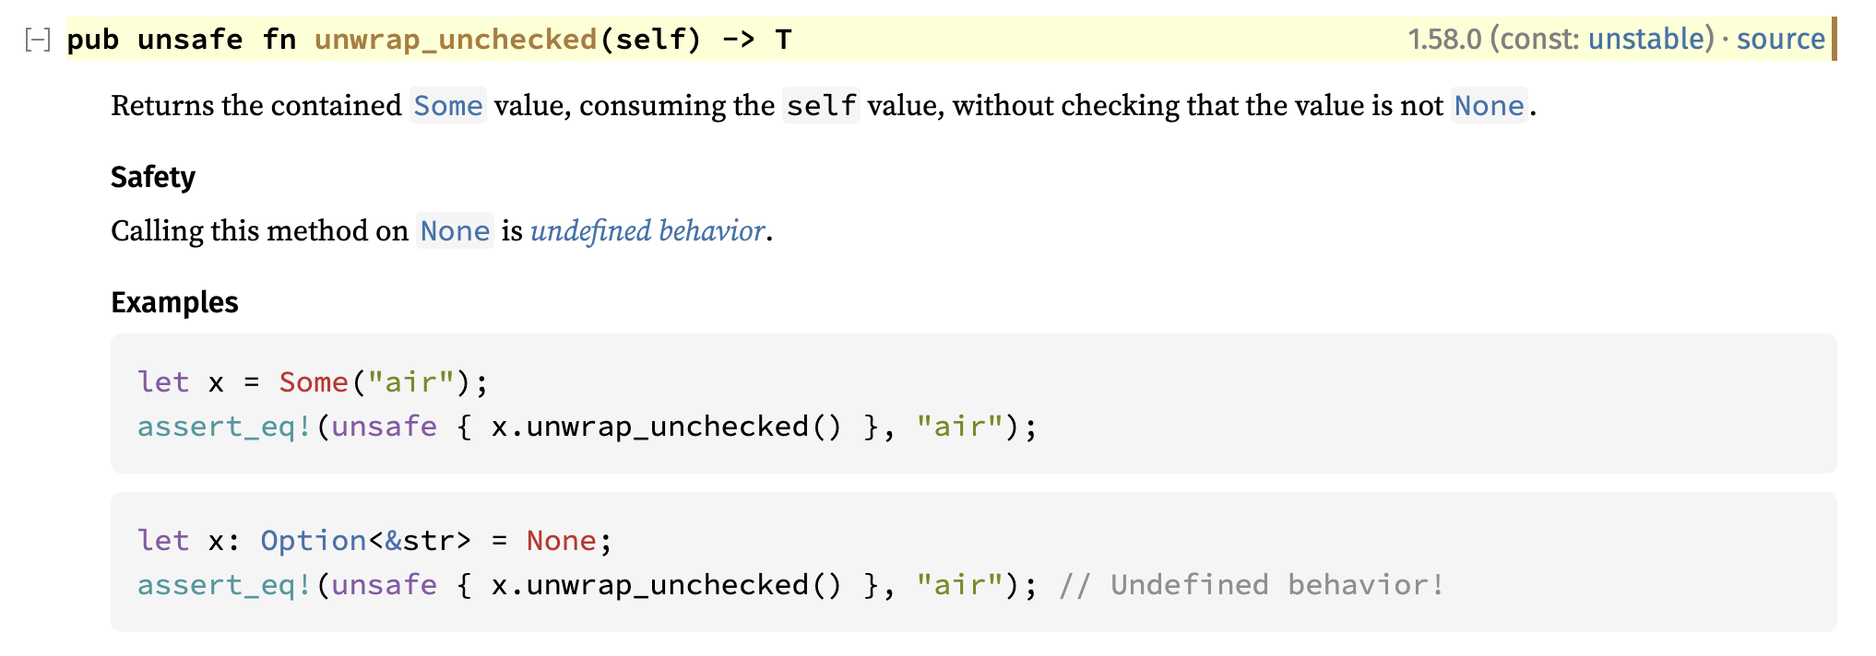
Example: Option::unwrap_unchecked
The subtext here is that behavior is defined if self is Some(_)
https://doc.rust-lang.org/std/option/enum.Option.html#method.unwrap_unchecked

Slide 8
What is unsafe code?
Definition attempt #2:
Unsafe code is code that has additional requirements (beyond Rust’s type checker) to guarantee memory safety
impl<T> Option<T> {
fn unwrap_unchecked(self) -> (res: T)
requires self.is_some()
ensures self == Some(res)
{
/* ... */
}
}
These requirements can be made explicit and formal using Verus preconditions

Slide 9

Unsafe Code
Notes:
Put this way, unsafe code doesn’t sound so bad. “Unsafe code” just means it has a requires clause, which is what you all have been practicing with all day. But —

Slide 10

Unsafe pointers

Slide 11
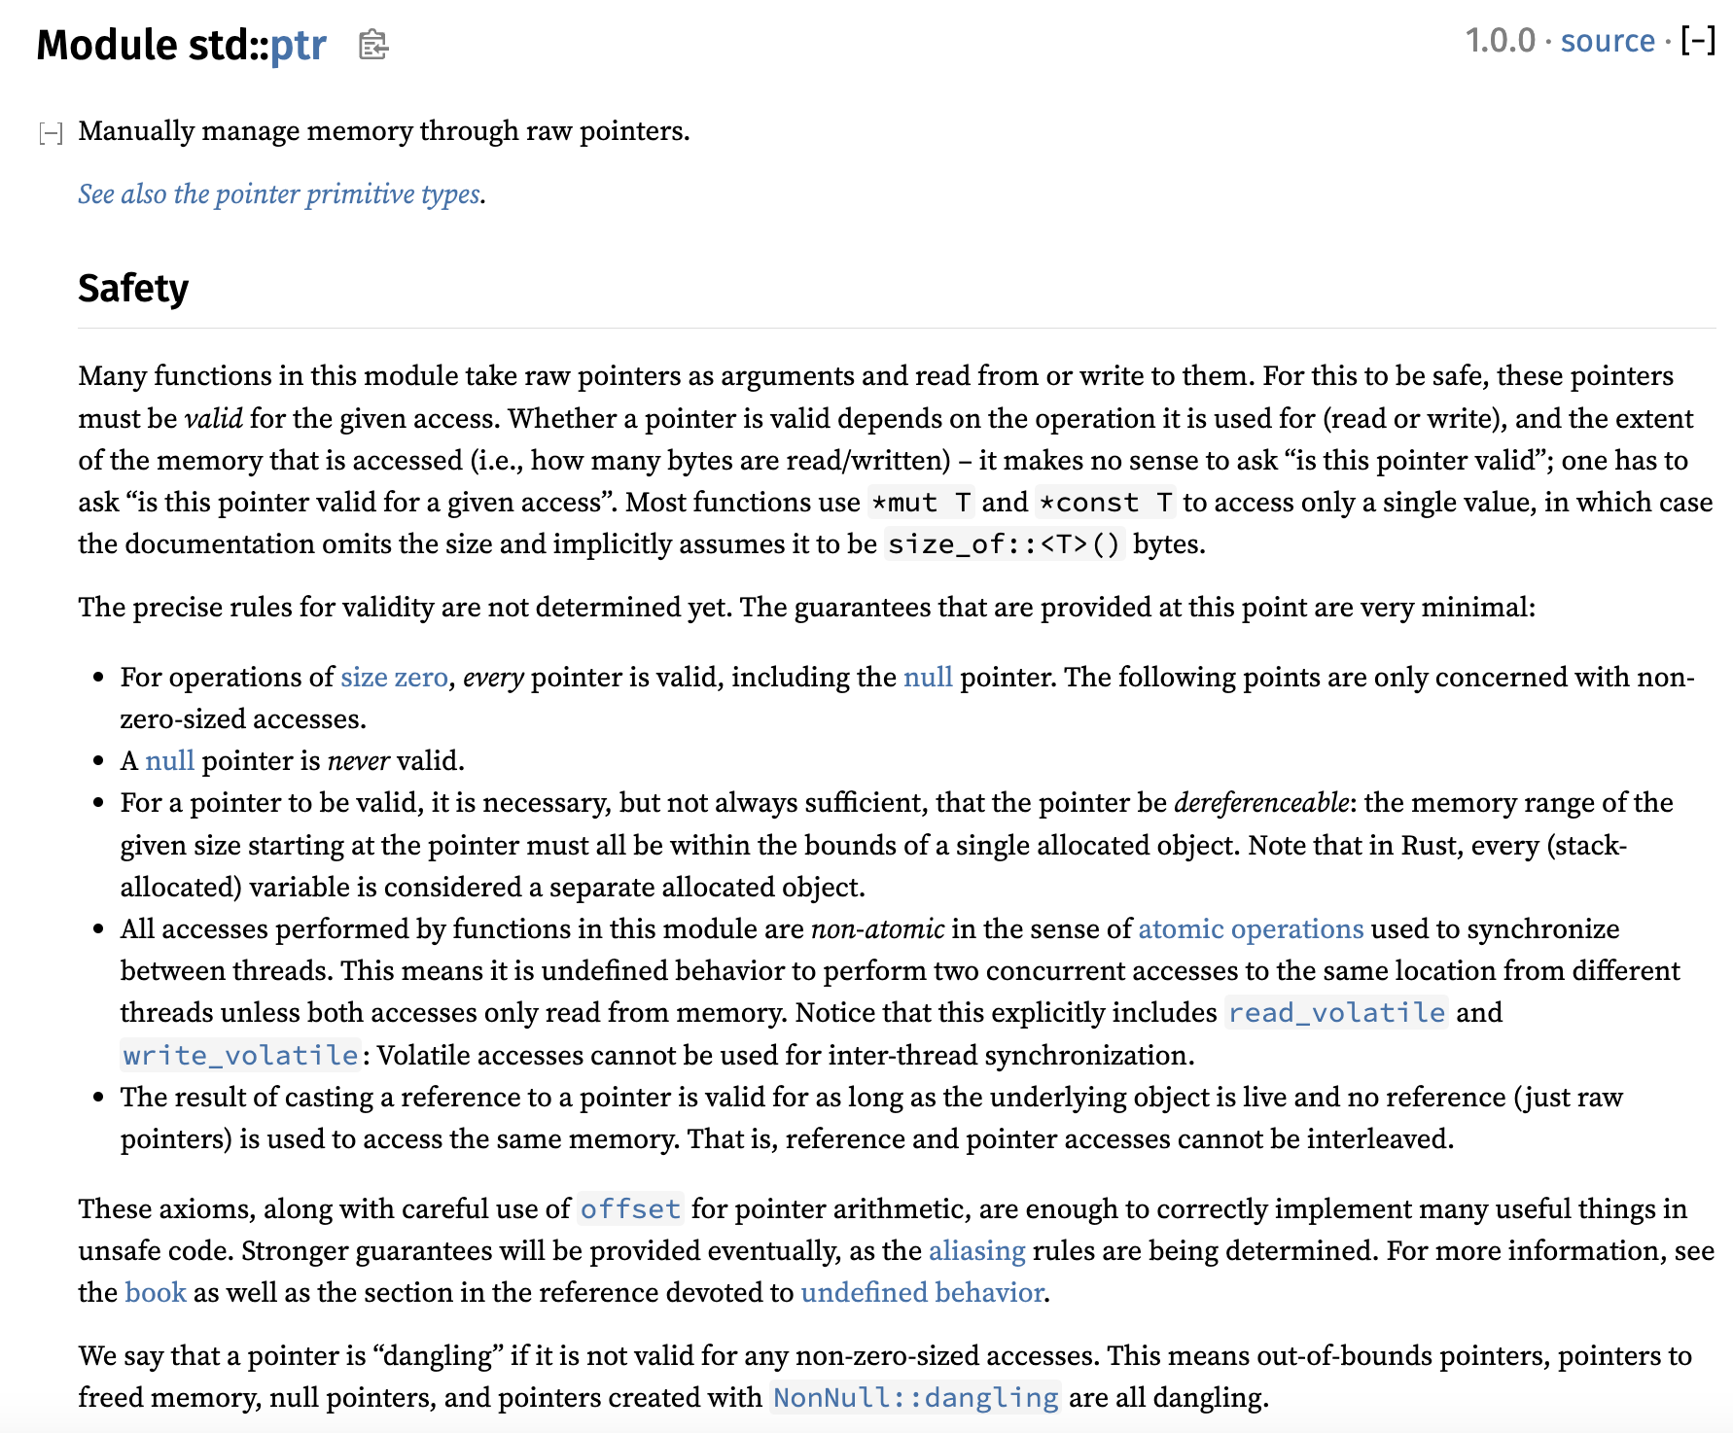
Let’s check the docs again

Slide 12
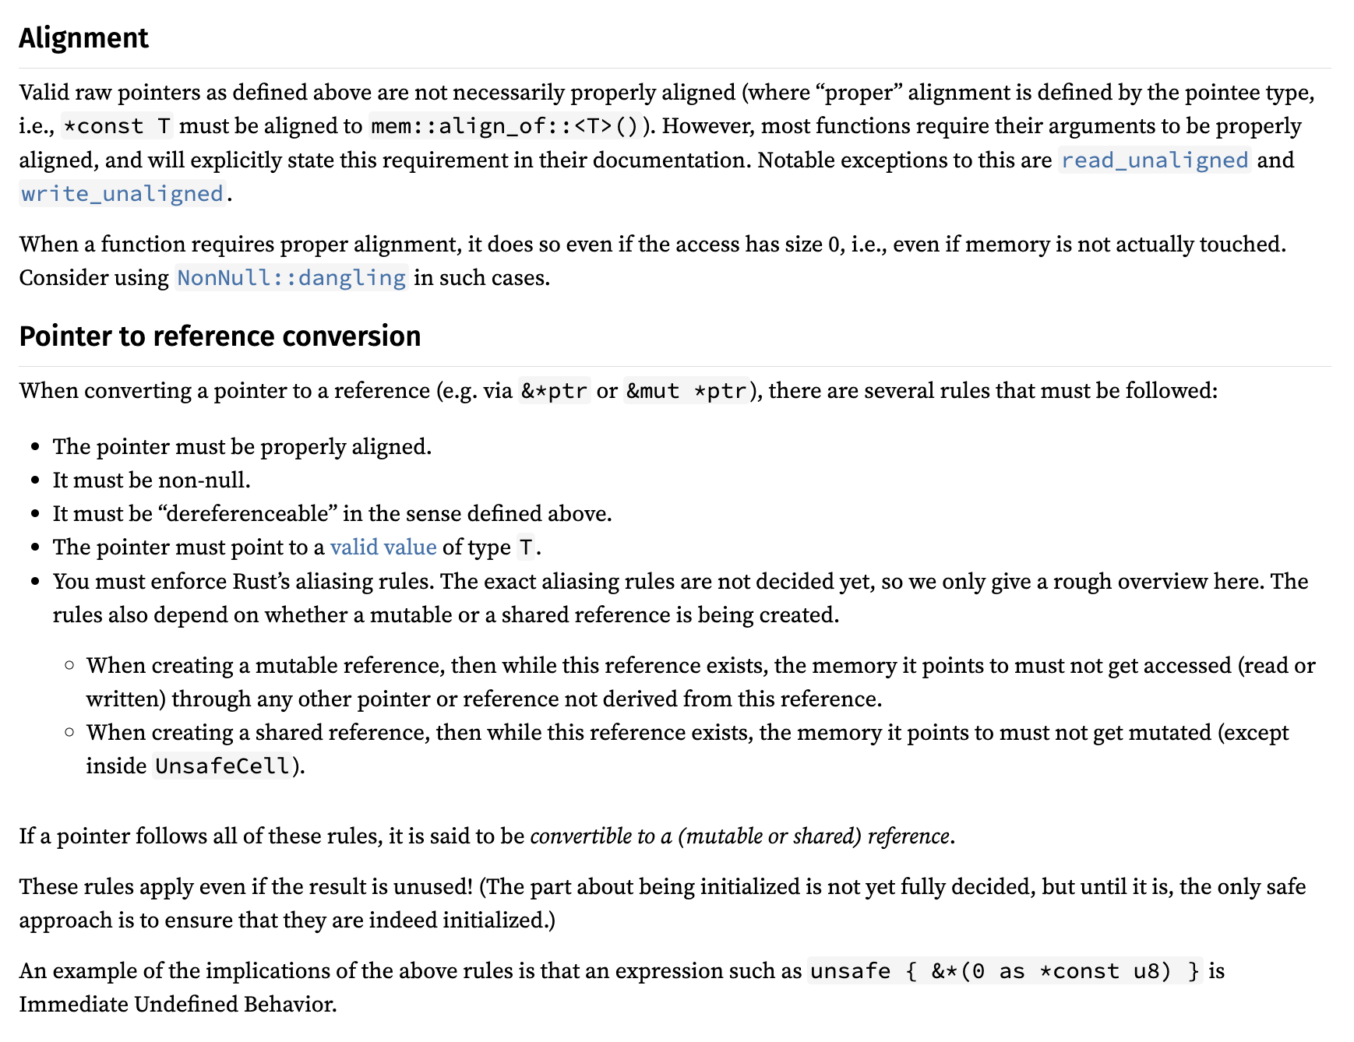
Let’s check the docs again

Slide 13
Let’s check the docs again

Slide 14
Pointers have a lot of requirements
Accessing a pointer requires:
Memory is valid, allocated, well-aligned
Reads must be initialized
Accesses are data-race-free
Place nice with reference system (&T and &mut T)
Handling “pointer provenance”
Can these condition even be expressed via Verus preconditions?

Slide 15

Isn’t this what ownership types are for?
Ordinarily, Rust’s type system, together with its clever standard library types (&T, &mut T, Box<T>, Rc<T>, Arc<T>, RefCell<T>, …), ensure that all the rules are followed
But the whole point of using “raw pointers” is that we can’t use those types…
Now we’re just going in circles!

Slide 16
Isn’t this what ownership types are for?
Ordinarily, Rust’s type system, together with its clever standard library types (&T, &mut T, Box<T>, Rc<T>, Arc<T>, RefCell<T>, …), ensure that all the rules are followed
But the whole point of using “raw pointers” is that we can’t use those types…
Solution: Decouple the ownership reasoning from the physical pointers; reason about ownership in “proof code”

Slide 17
Pointers have a lot of requirements
Accessing a pointer requires:
Memory is valid, allocated, well-aligned
Reads must be initialized
Accesses are data-race-free
Place nice with reference system (&T and &mut T)
Handling “pointer provenance”
For the demo & exercise, we’ll use Verus’s “Simple PPtr” library, which sands down the rougher edges at the cost of generality — but it still covers the key points

